Slide 1
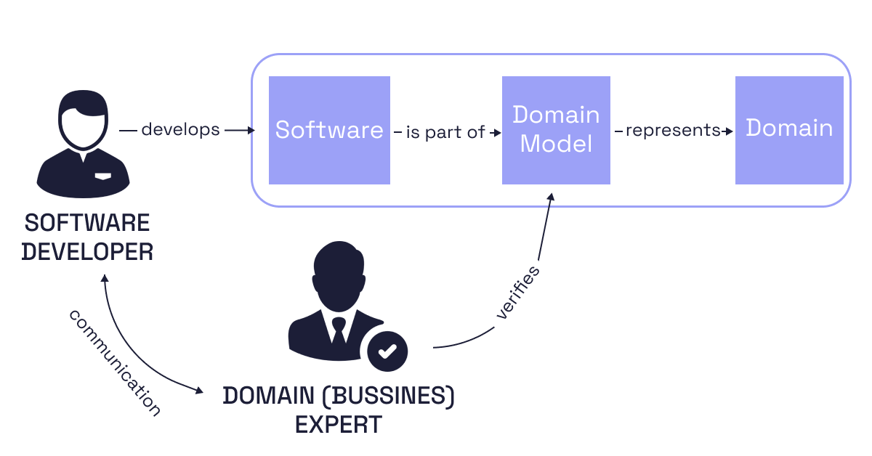
The CPSA® Advanced Level Module DDD
Day 1: Foundations - Domain, Model & Ubiquitous Language
iSAQB® Training Course in Domain-Driven Design
22 December 2025
VOLKSWAGEN GROUP INDIA

Slide 2







Introduction to Shared Understanding
Communication Challenges
Automotive Impact
Lost in Translation
Real-World Consequences
Different vocabularies between teams
Feature delays from misunderstood requirements
Misinterpreted requirements due to terminology
Integration failures between vehicle systems
Implementation gaps from misunderstood concepts
User experience issues from inconsistent terminology
Endless clarification cycles
Safety risks from ambiguous specifications
"The most disastrous thing that can happen to a software project is to have wrong people making key decisions."
- Eric Evans, Author of Domain-Driven Design
The CPSA® Advanced Level Module DDD – iSAQB® Training Course
Volkswagen Group India | 22 December 2025

Slide 3












Automotive Software Complexity
Software Complexity Metrics
Domain Distribution
100M+
150+
Software Code Distribution
Lines of Code
ECUs in Premium Vehicles
Infotainment
25%
Powertrain
20%
Safety Systems
18%
Multiple Domains
Connectivity
15%
Powertrain - Engine, transmission, battery management
Body Control
12%
Infotainment - Media, navigation, connectivity
Other Systems
10%
Safety - ADAS, airbags, collision avoidance
Connectivity - OTA updates, V2X communication
Cross-Team Challenges
Integration complexity between domains
Communication barriers between specialized teams
Evolving requirements across vehicle systems
The CPSA® Advanced Level Module DDD – iSAQB® Training Course
Volkswagen Group India | 22 December 2025

Slide 4







Introduction to Ubiquitous Language
What is Ubiquitous Language?
Why It Matters
Shared Vocabulary
Key Benefits
Common terminology between domain experts and developers
Reduces ambiguity in requirements
Improves collaboration between teams
Precise meanings for domain concepts
Creates alignment between business and technical
Consistent usage across code and documentation
Simplifies maintenance of complex systems
Evolution through collaboration
In Automotive Software
Powertrain
Infotainment
Safety
The CPSA® Advanced Level Module DDD – iSAQB® Training Course
Volkswagen Group India | 22 December 2025

Slide 5




Learning Goals
1-1
Domain Connections
1-2
Ubiquitous Language
Explain connections between domains, software, and models
Understand role of ubiquitous language in domain modeling
1-3
DDD Building Blocks
1-4
Block Connections
Explain DDD building blocks (Entities, Value Objects, Aggregates)
Explain connections between building blocks
The CPSA® Advanced Level Module DDD – iSAQB® Training Course
Volkswagen Group India | 22 December 2025

Slide 6









Key Concepts of Ubiquitous Language
Bounded Context
Shared Vocabulary
Language Evolution
Explicit boundary where a specific domain model applies
Common terms used by all stakeholders
Iterative refinement through collaboration
Linguistic boundary for consistent terminology
Precise meanings for domain concepts
Living documentation that evolves with understanding
Team alignment with domain ownership
Consistent usage in code and documentation
Versioned glossary for terminology management
Automotive Example
Powertrain
Infotainment
Safety
Connectivity
The CPSA® Advanced Level Module DDD – iSAQB® Training Course
Volkswagen Group India | 22 December 2025

Slide 7







Creating and Evolving Ubiquitous Language
Evolution Process
Best Practices
Iterative Refinement
Language Development
1
Gather Terms
•
Collaborative Creation - Involve all stakeholders
Interview domain experts, collect existing terminology
•
Document Glossary - Centralized terminology reference
2
Refine Meanings
Discuss with stakeholders, resolve ambiguities
•
Consistent Usage - Enforce in code and documentation
3
Model Concepts
Apply refined language to domain model
•
Regular Refinement - Schedule periodic reviews
4
Apply Consistently
Use in code, documentation, and discussions
Automotive Success Factors
Cross-Team Workshops
Living Documentation
Code-First Vocabulary
Iterative Evolution
The CPSA® Advanced Level Module DDD – iSAQB® Training Course
Volkswagen Group India | 22 December 2025

Slide 8




Analogies for Ubiquitous Language
Medical Field
Legal Field
Scientific Research
Precise terminology for body parts, symptoms, treatments
Specific language for contracts, clauses, precedents
Standardized terminology for methods, results, conclusions
Universal understanding between doctors, nurses, technicians
Shared vocabulary across legal teams
Peer review with common language
Clear documentation with precise terms
Knowledge transfer through precise communication
Reduced errors from miscommunication
DDD Connection
Just as specialized fields develop precise terminology, ubiquitous language creates shared understanding between domain experts and developers in software
The CPSA® Advanced Level Module DDD – iSAQB® Training Course
Volkswagen Group India | 22 December 2025

Slide 9




Automotive Examples of Ubiquitous Language
Powertrain
Infotainment
Safety Systems
Torque
MediaSource
SafetyZone
Rotational force, not "power" or "strength"
Source type, not "player" or "format"
Defined area, not "safe space"
AlertLevel
GearRatio
Playlist
Severity level, not "warning" or "alarm"
Precise ratio, not "gear setting"
Ordered collection, not "song list"
ThrottlePosition
CollisionEvent
Position value, not "acceleration"
NavigationRoute
Specific occurrence, not "crash" or "impact"
Complete path, not "directions" or "map"
The CPSA® Advanced Level Module DDD – iSAQB® Training Course
Volkswagen Group India | 22 December 2025

Slide 10







Case Study: Mercedes-Benz MBUX System
MBUX Approach
DDD Implementation
Consistent Language
Model Elements
Unified terminology across all interfaces
UserInterfaceSession - Tracks interaction state
User-centric vocabulary for all features
MediaMetadata, Coordinates - Value objects
Shared understanding between UX and engineering
InfotainmentAggregate - Manages connected features
Integration Benefits
Clear boundaries between vehicle systems
Consistent terminology across vehicle functions
Simplified maintenance through clear concepts
"MBUX demonstrates how a consistent, user-centric language creates a unified experience across complex vehicle systems."
- Automotive UX Analysis
The CPSA® Advanced Level Module DDD – iSAQB® Training Course
Volkswagen Group India | 22 December 2025

Slide 11







Reverse Engineering: Audi MMI Interface
MMI System Analysis
DDD Implementation
Language Consistency
Model Elements
Media Control - Consistent terminology across audio sources
UserInterfaceSession - Tracks interaction state
MediaMetadata, Coordinates - Value objects
Navigation - Standardized route and destination terms
InfotainmentAggregate - Manages connected features
Connectivity - Unified phone integration vocabulary
Integration Patterns
Bounded Contexts for different MMI modules
Consistent terminology across MMI interfaces
Audi's MMI demonstrates clear separation of concerns with consistent terminology across infotainment, navigation, and vehicle controls
The CPSA® Advanced Level Module DDD – iSAQB® Training Course
Volkswagen Group India | 22 December 2025

Slide 12








Brainstorming Puzzles: Creating Ubiquitous Language
1
EV Charging System
A system with multiple teams working on charging, payment, and battery management. Each team uses different terms for "charging session."
Create Ubiquitous Language
ChargingSession
PaymentTransaction
BatteryState
2
Vehicle Safety Features
Safety engineers use "brake assist" while UX designers use "emergency stop" for the same feature.
Resolve Terminology
AutomaticEmergencyBraking
CollisionAvoidance
ProximityDetection
3
Infotainment Controls
Users interact with media, navigation, and climate control through different interfaces with inconsistent terminology.
Unify Interface Language
UserInteraction
ControlMode
SystemState
The CPSA® Advanced Level Module DDD – iSAQB® Training Course
Volkswagen Group India | 22 December 2025

Slide 13



Scenarios and Solutions: When Terminology Conflicts Arise
Cross-Team Conflicts
Solution Approach
Bounded contexts for different domains
Different teams using inconsistent terminology for same concepts
Glossary creation with clear definitions
Regular alignment meetings between teams
Evolving Requirements
Solution Approach
Domain expert workshops for terminology refinement
Business terminology changing during development
Versioned glossary with change tracking
Living documentation that evolves with language
Technical vs. Business
Solution Approach
Code comments mapping technical to business terms
Developers using technical terms that business users don't understand
Translation layer between technical and business terms
User-facing documentation with business terminology
The CPSA® Advanced Level Module DDD – iSAQB® Training Course
Volkswagen Group India | 22 December 2025

Slide 14







Self-Study Resources for Ubiquitous Language
Books
Articles
Domain-Driven Design
Ubiquitous Language in Practice
Eric Evans - Ubiquitous Language chapter
Alberto Brandolini - Practical examples and patterns
Implementing DDD
Strategic Domain-Driven Design
Vaughn Vernon - Bounded Contexts examples
Eric Evans - Language patterns and context mapping
DDD Distilled
EventStorming Guide
Jimmy Nilsson - Strategic Design and language
DDD-Crew - Collaborative modeling techniques
Online Resources
Practical Exercises
DDD Community
Terminology Mapping
Forums, discussions, and language examples
Map conflicting terms between teams
Glossary Tools
Software for creating and managing ubiquitous language
Workshop Templates
Glossary Creation
Guides for language creation workshops
Build shared vocabulary for a domain
Language Evolution
Document changes to terminology over time
The CPSA® Advanced Level Module DDD – iSAQB® Training Course
Volkswagen Group India | 22 December 2025

Slide 15










Connecting to Day 2
Day 2 Topics
Self-Study Preparation
Knowledge Crunching
Key Concepts
Working with domain experts
Domain expert empowerment
Collaborative modeling techniques
Communication models between teams
EventStorming and Domain Storytelling
Knowledge elicitation techniques
Preparation Activities
Document existing terminology in your project
Identify conflicting terms between teams
Practice collaborative modeling techniques
The CPSA® Advanced Level Module DDD – iSAQB® Training Course
Volkswagen Group India | 22 December 2025

Slide 16




Summary of Ubiquitous Language
Key Takeaways
Automotive Impact
Shared Understanding
•
Clear boundaries between vehicle systems
•
Common vocabulary bridges communication gaps
•
Consistent terminology across interfaces
•
Precise meanings reduce ambiguity
•
Simplified maintenance through clear concepts
•
Consistent usage in code and documentation
Value for Volkswagen Projects
Automotive Software Excellence
Faster Development
Better Decision Making
Cross-Team Collaboration
The CPSA® Advanced Level Module DDD – iSAQB® Training Course
Volkswagen Group India | 22 December 2025

Slide 17







Summary of Ubiquitous Language
Key Takeaways
Automotive Impact
•
Clear boundaries between vehicle systems
Shared Understanding
•
Consistent terminology across interfaces
•
Common vocabulary bridges communication gaps
•
Simplified maintenance through clear concepts
•
Precise meanings reduce ambiguity
•
Consistent usage across code and documentation
Connection to DDD
Building Blocks
•
Ubiquitous language defines domain concepts
•
Bounded contexts establish linguistic boundaries
•
Domain events communicate across contexts
Value for Volkswagen Projects
Automotive Software Excellence
Faster Development
Better Decision Making
Cross-Team Collaboration
The CPSA® Advanced Level Module DDD – iSAQB® Training Course
Volkswagen Group India | 22 December 2025

